Slide 1
FashionBrain: Understanding Europe’s Fashion Data Universe
Gianluca Demartini
Senior Lecturer in Data Science
University of Sheffield, UK

Slide 2
FashionBrain Consortium
Project Duration 2017-2019. Funded under the H2020-ICT-14-2016 topic Big Data PPP: cross-sectorial and cross-lingual data integration and experimentation. Total cost: 2.9M EUR.

Slide 3
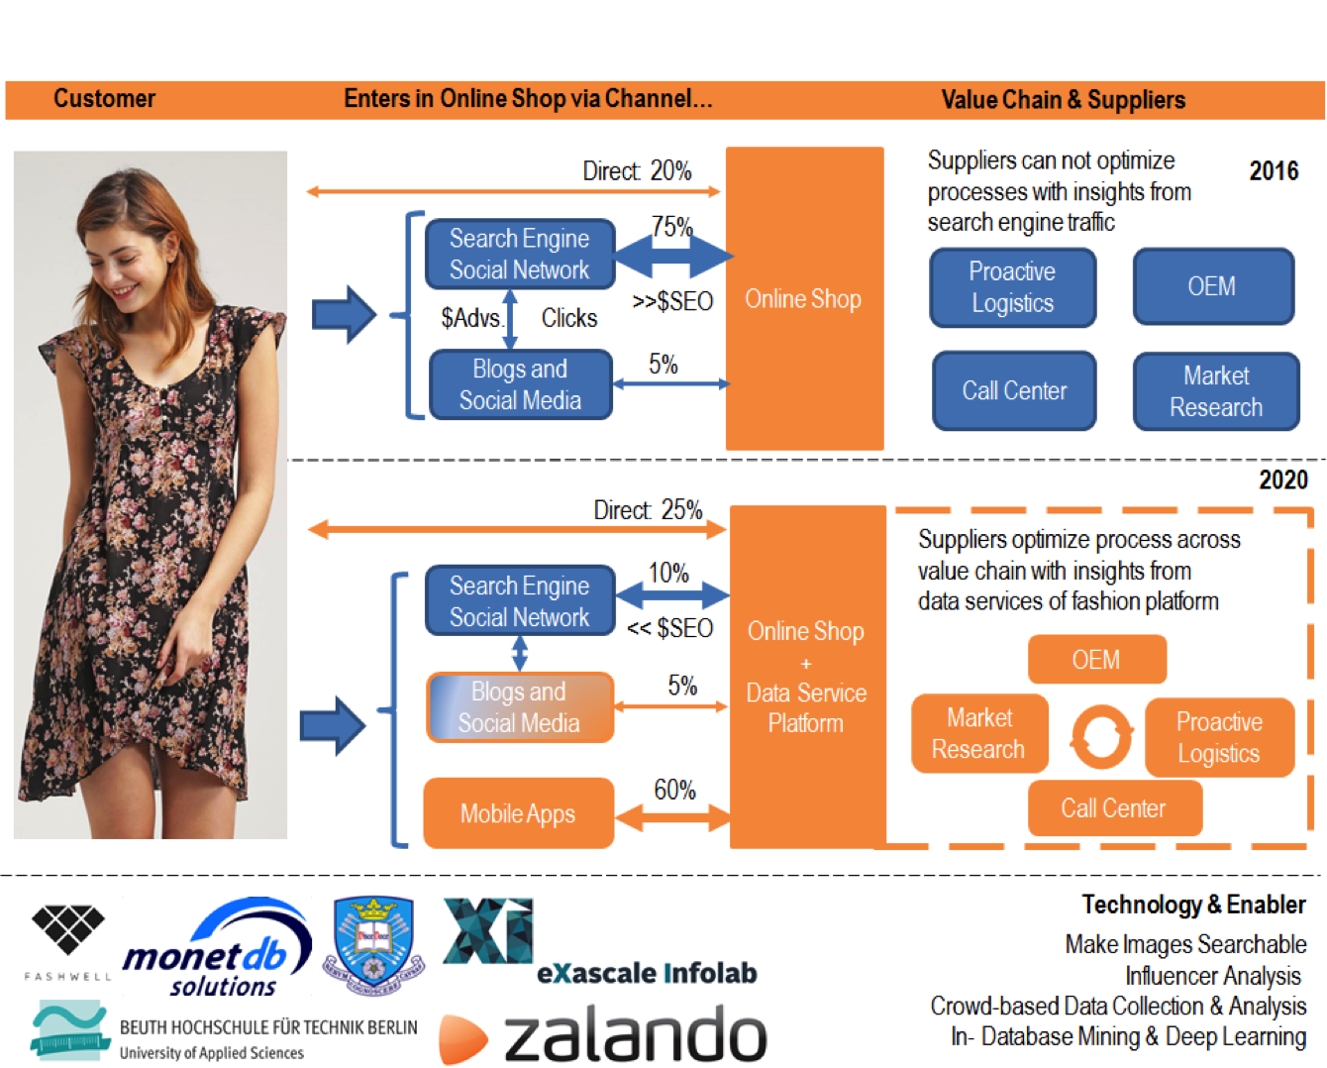

Slide 4
Data Challenges in the Fashion Industry
Data is not used in an integrated fashion
Data is stored in silos
Each data source owns data in different formats and platforms
Search engines dominate customer behaviors
Search engines and social network companies are in a strong position to settle a new global monopoly on customer understanding thanks to AI technology
Retailers have limited access to customer data
Fashion bloggers influence customer choices
Limited understanding on bottom-up changes in fashion
Shift from traditional stylist-driven fashion

Slide 5
FashionBrain Objectives
Novel Shopping Experience: Make Images Searchable
Product search and recommendation
Moving away from the ’real human shop assistants’
Shift Traffic away from Web Search Engines to Retailer's Mobile Apps
By providing custom shopping experiences and advanced search tools
Detect Influencers and Predict Fashion Trends
Time Series Analysis
Social Media data
Share Insights with Cross Industry Partner Network
Data Integration infrastructure based on HDFS and column stores

Slide 6
Exploitation of Business Data Assets
Data integration and value creation across
Shop Inventory of around 100 online shops
Social Media (Fashion bloggers)
User reviews about fashion products in 11 languages
Product catalogs
OEM manufacturer information
Sales data
Web crawls
Crowd-generated data

Slide 7
Measurement of data exploitation
Demos; Algorithms; Impact on sales;
Data asset | Exploited by | Impact on business partners
Shop Inventory of around 100 online shops | Fashwell | Used for Photo-based product search demos
Social Media (Fashion bloggers) | Fashwell | Used for Photo-based product search demos
User reviews about fashion products in 11 languages | Zalando | Demonstrator of text join and relation extraction methods
Product catalogs | Zalando | Used for Photo-based product search demos
OEM manufacturer information | Zalando | Supply chain optimization
Sales data | Zalando | Time Series analysis; Trend detection demo
Web crawls | Beuth | Identification of fashion-related content; Demonstrator of text join and relation extraction methods
Crowd-generated data | All | Used for Photo-based product search demos; Trend detection demo

Slide 8
FashionBrain - Data Value Chain
New data entity-centric integration methods
Named Entity Recognition and Linking across sources
New Data Technology
Time Series Analysis for Fashion Trend Detection
Deep Learning based Text Mining
Data-driven demos
Search by Image
Product Recommendation

Slide 9
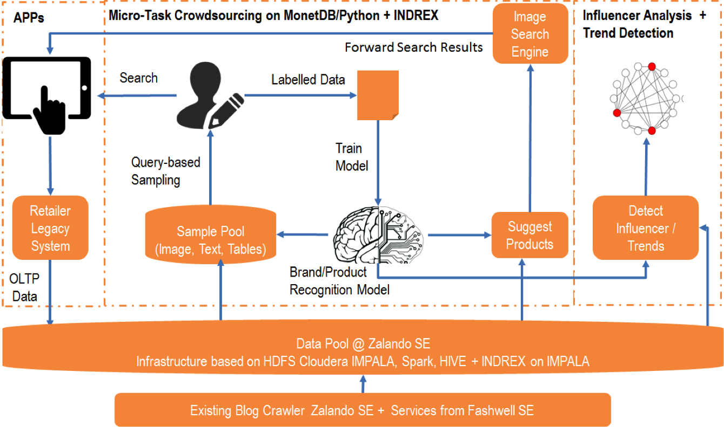
FashionBrain - Searching and shopping query workflows

Slide 10
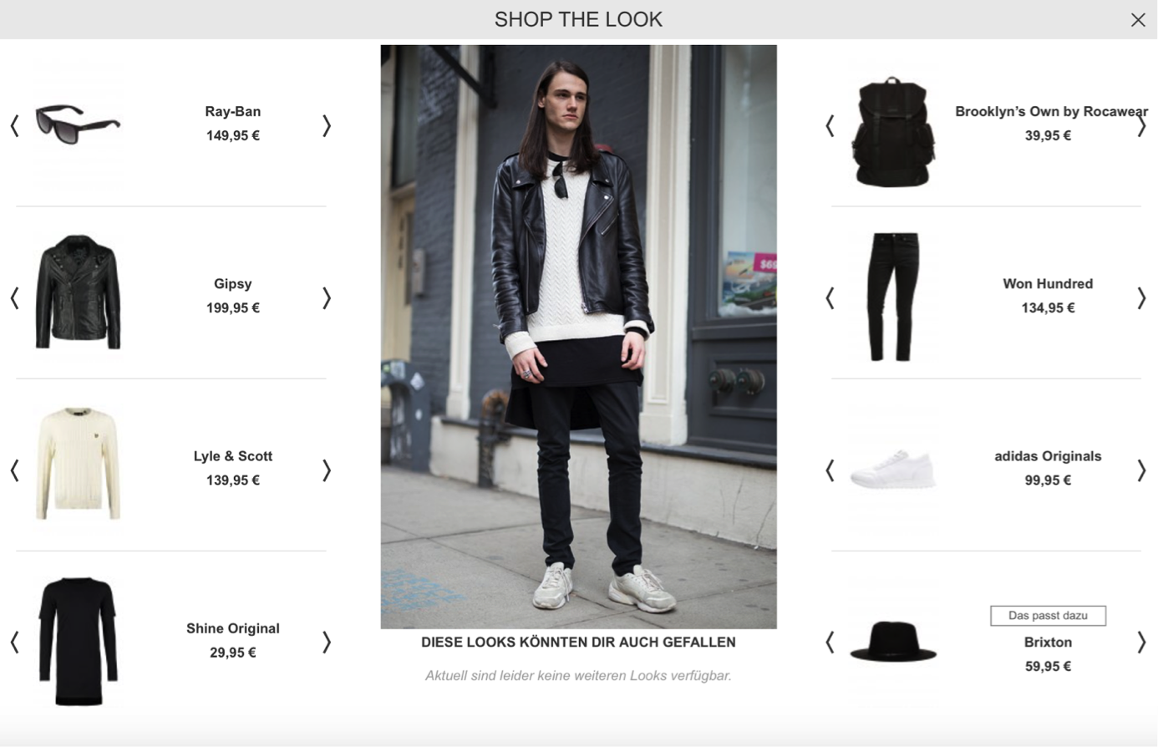
FashionBrain - Photo-based product search
Notes:
Example of photo-based product search. The user uploads a photo, the app generates links to the retailer's assortment for all products visible on the photo.

Slide 11
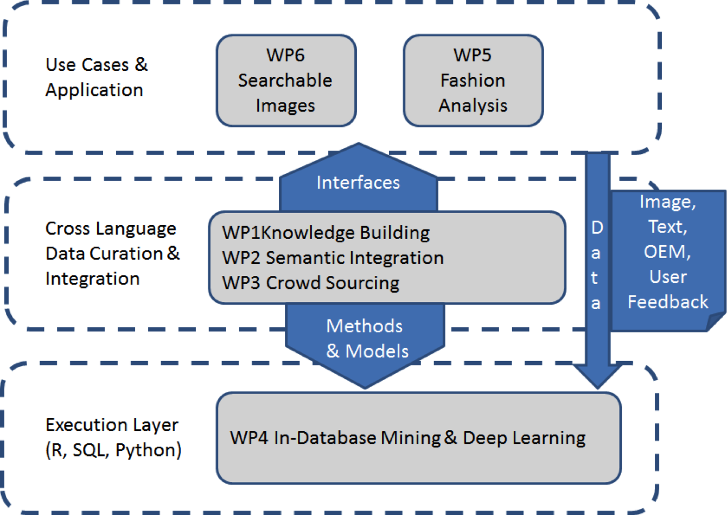
FashionBrain Project Roadmap
Year 1 - Foundations
Requirement Analysis
FashionBrain Schema
Datasets
Year 2 – Core techniques, data, demos
Named Entity Recognition and Linking
Time Series Analysis for MonetDB
Crowd Data Aggregation
Social Media Annotations
Demos
Year 3 – Advanced applications
Relation Extraction w/ Deep Learning
Final Demos (Trend Prediction, Search)
Business Plan

Slide 12
FashionBrain: Understanding Europe’s Fashion Data Universe
Gianluca Demartini, University of Sheffield, UK

